Slide 1

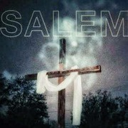



STEP TWO:[RENEW MY MIND WITH WORD OF GOD]
Ephesians 4:23
(And be renewed in the spirit of your mind)

Slide 2
Romans 12:2a
(And do not be conformed to this world, but be transformed by the renewing of your mind...)
This step is the most important to my Christian growth, survival and experience. While I were not born-again my mind had collected and developed a formidable amount of wrong information that was responsible for my wrong thoughts patterns. Wrong thoughts patterns then led to wrong life patterns.
That is why the BIBLE say in Isaiah 55:7" let the wicked forsake his way, and the

Slide 3
unrighteous men his thoughts..."
The only way I are going to forsake thoughts is by the renewing of my mind.
I see 'the way' of a man is made up of the following:
(i) HIS THOUGHTS (ii) HIS WORDS (iii) HIS ACTIONS
For a man to develop and maintain a godly way of life it then follows that his thought life must change, his speech must become godly and his actions most be godly.
Psalm 119:9
(How can a youngman cleanse his way? BY TAKING HEED ACCORDING TO YOUR WORD!)

Slide 4
That is the key. The word of GOD must first be applied to my thought patterns. I need to acquire new thinking patterns that are in line with the word of GOD.
Then my language must correspond to the word of GOD. Only then can my actions be godly. That is the same messages GOD gave Joshua.
Joshua 1:8
(This book of the law shall not depart out of thy mouth; but thou shalt meditate therein day and night, that thou mayest observe to do according to all that is written therein: for then thou shalt make thy way prosperous, and then

Slide 5
thou shalt have good success.)
GOD was basically telling Joshua to CHANGE!
Change my thoughts meditate on the word day and night. Change my language let the word in my mouth Change my actions do according to the word of GOD. See the process again THOUGHT give birth to WORDS, WORDS give birth ACTIONS!
I need to now begin a process of reduction of myself according to the BIBLE.
For too long I have believe and thought wrongly about GOD, the devil, myself, sin, sickness, infact life itself. That led to wrong talking about these which in turn has led to wrong actions relating to these.

Slide 6
The solution is to renew my mind. The agent of that renewal is the word of GOD especially those IN-CHRIST SCRIPTURES. Change my thought patterns to correspond to those scriptures and very soon those scriptures will become my language and I will begin to act like them.
I will notice that this step is link between putting off the old man and putting on the new man!
I can never successfully put off the old man nor can I effectively put on the new man without renewing my mind with the word of GOD.
STEP THREE:PUT ON THE NEW MAN

Slide 7

Ephesians 4:24
(And that ye put on the new man, which after God is created in righteousness and true holiness.)
Colossians 3:10
(And have put on the new man, which is renewed in knowledge after the image of him that created him:)

Slide 8
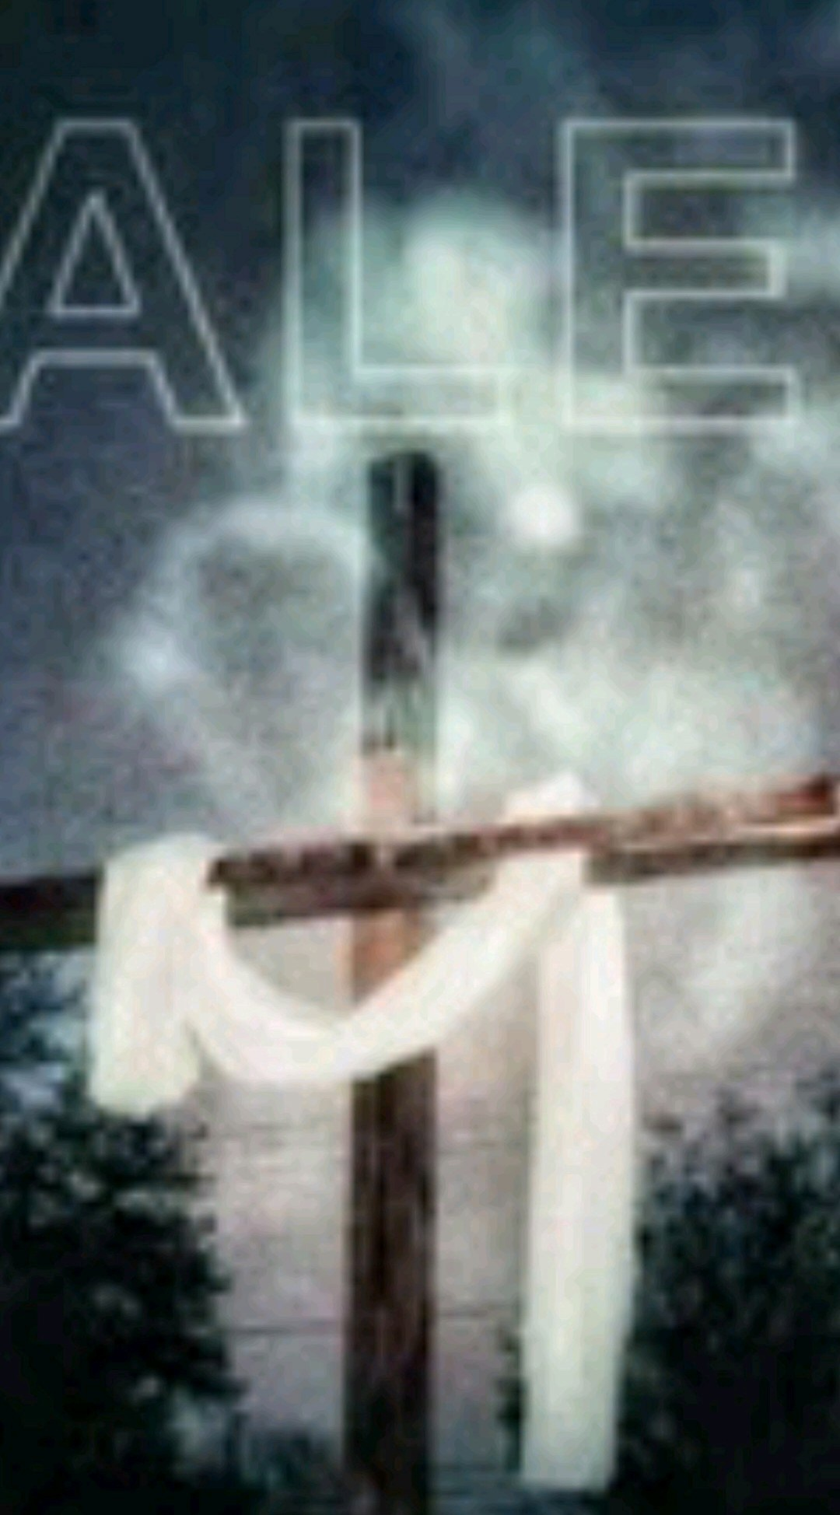
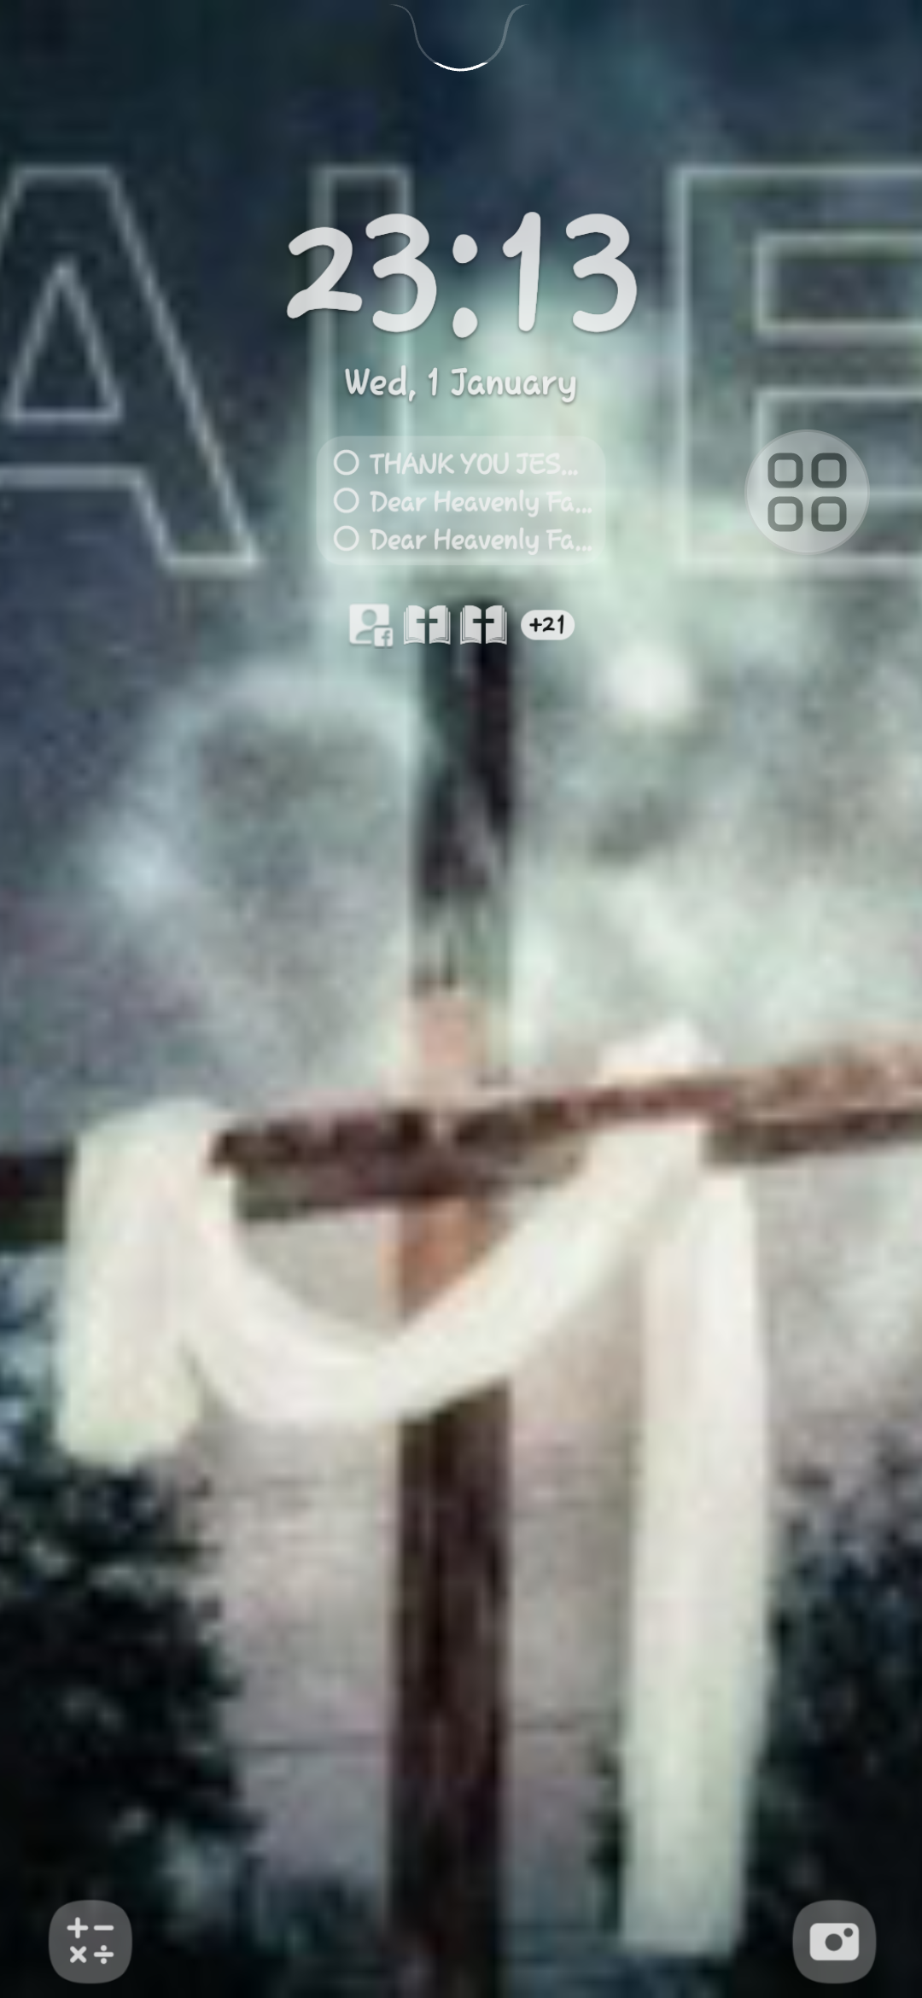

Slide 9

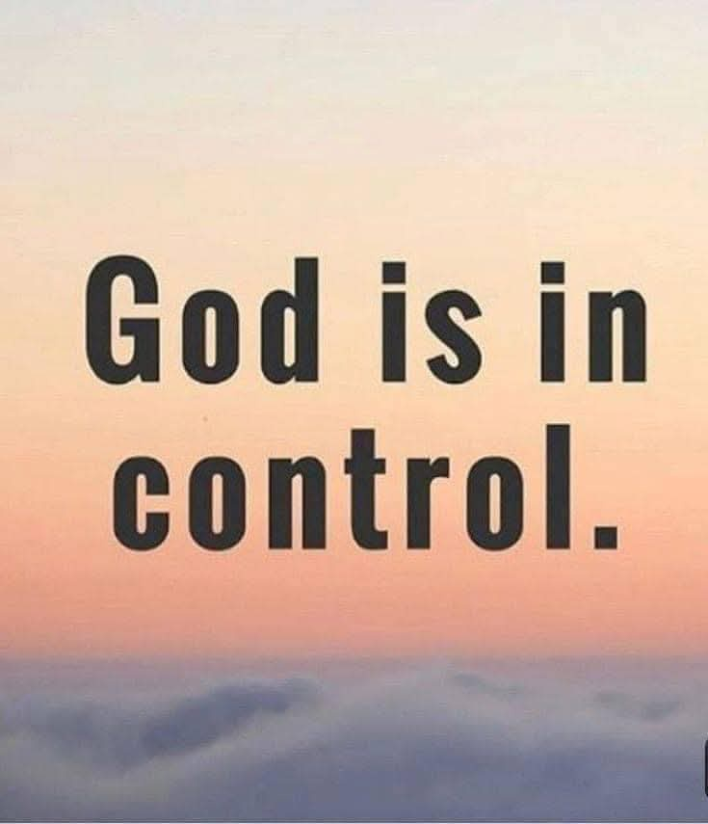
This step is only possible as I faithfully practice step two.
To put on means to allow the new man to show up on the outside.

Slide 10
The new man in the BIBLE is exactly like GOD, acts like GOD, talks like GOD etc. He will come to the surface on the measure that my mind is renewed with the word of GOD.
The new man has all the attributes of GOD in him and as I allow the word of GOD to grow in I and renew my mind, he also grows in these attributes and people begin to see a transformation taking place in I. I begin to think more,and act more like CHRIST.
Godly Counsels
Let OLUSOLA A. AREOGUN share with me Godly counsel that will keep me moving forward and upward in JESUS. BUILD NOT AGAIN THINGS I HAVE DESTROYED.
Galatians 2:18

Slide 11
(For if I build again the things which I destroyed, I make myself a transgressor.)
I have confessed JESUS as my LORD and Savior. I have renounced my former ways.
I should not let situations and circumstance force me to build those things again. Be not like the proverbial dog that always returns to eat its vomit. BURN THE BRIDGE ONCE AND FOR ALL TIME. Make it impossible for my former ways to find expressions again.
To achieve this, immediately cut off all associations and situations that have the potentials of talking you back into those former things.
Remember, for we have spent enough of our past life doing the will of the Gentiles

Slide 12
when we walked in licentiousness, lusts, drunkenness, reversies, drinking parties, abd abominable idolatrius.
In regards to these, they( those former associates in sin) think it strange that I ( now a child of GOD) I should not run with them in same flood of dissipation, speaking evil of I (that is a form of persecution) 1pet.4:3-4.
The BIBLE warns further on the possibility of going back and its danger.
2 Peter 2:20
(For if after they have escaped the pollutions of the world through the knowledge of the Lord and Saviour Jesus Christ, they are again entangled therein, and overcome, the latter

Slide 13
end is worse with them than the beginning.)
Look also at Hebrew 3:12-4
( Take heed, brethren, lest there be in any of you an evil heart of unbelief, in departing from the living God.
But exhort one another daily, while it is called To day; lest any of you be hardened through the deceitfulness of sin.
For we are made partakers of Christ, if we hold the beginning of our confidence stedfast unto the end;)
There are three main reasons highlighted that can lead to a believer building those things he once destroyed again.

Slide 14
(a) wrong associations
(b) secret sin
(c) lack of fellowship
The solution is also highlighted in Heb. 3:13,"...exhort one another daily ".Make new grounds in faith daily.
Christian growth is a daily affair. It is a continuous affair too.
You as a believe have got to resolutely determine that I will only move if it is a step FORWARD AND UPWARD.
That is, daily I are making progress in my Christian experience and I are getting

Slide 15
heaven-ready or rapture-fit. I have got to take away my gaze for every other thing and fix them resolutely on JESUS. Never look sideways or backwards. 'Remember lot'wife.
Therefore we also, since we are
Surrounded by so great a cloud of
Witness let us aside every
Weight and the sin which so
easily ensnares us, and let us run
With endurance the race that is set
before us, LOOKING OUTO
JESUS, the author and finisher of
Our faith, who. for the joy that
was set before HIM, endured the
cross, disposing the shame and
has sat down at the right hand of
the throne of GOD

Slide 16
-Hebrew. 12:1-3.
Hosea 6:3a
( Then we shall know IF WE
FOLLOW ON TO KNOW THE
LORD)
JOHN:8:31
(Then said Jesus to those Jews which believed on him, If ye continue in my word, then are ye my disciples indeed;)
Hebrew 6:1(Williams)
(So then let us oncefor all quit the
elementary teaching about CHRIST
and CONTINUE PROGRESSING
TOWARD MATURITY)

Slide 17

I must determine to grow in grace. I must follow after the LORD to know HIM the more.
Determine that my today shall be better than my yesterday in CHRIST.

